Slide 1
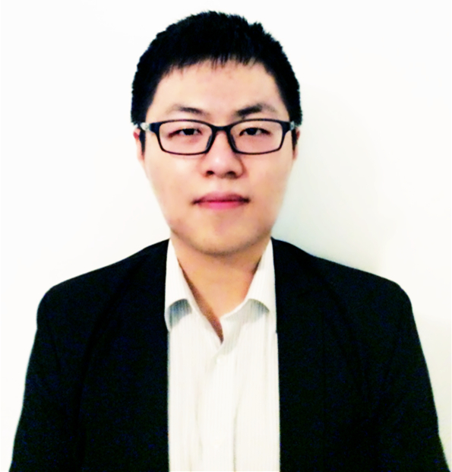
GPU Acceleration for Fixed Complexity Sphere Decoder in Large MIMO Systems
Tianpei Chen and Harry Leib
Department of Eelectrical and Computer Engineering,
McGill University
Montreal, Quebec, Canada
General Purpose Graphic Processing Units Computing (GPGPU).
Computed Unified Device Architecture (CUDA).
Computer Simulation of Large MIMO Uplink Systems.
Fixed Complexity Sphere Decoder (FCSD).
A figure here
For figure caption (optional), use arial narrow 20pt font

